Slide 1
Technical English for Computer Science
Week 4
Dr. Nur Banu OĞUR

Slide 2
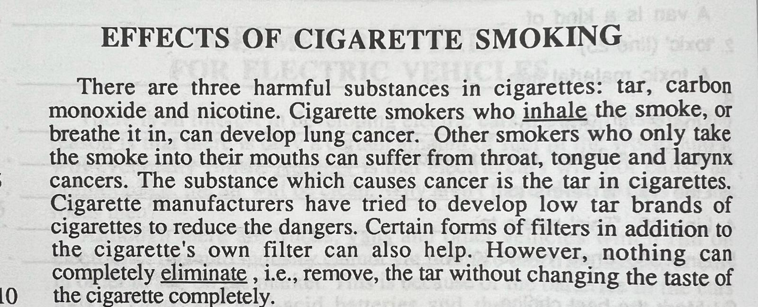

Slide 3
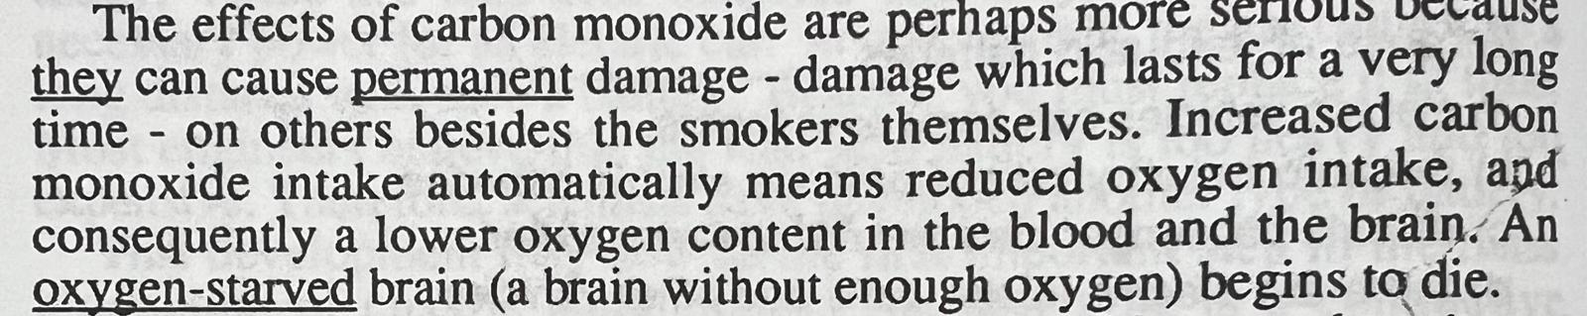

Slide 4
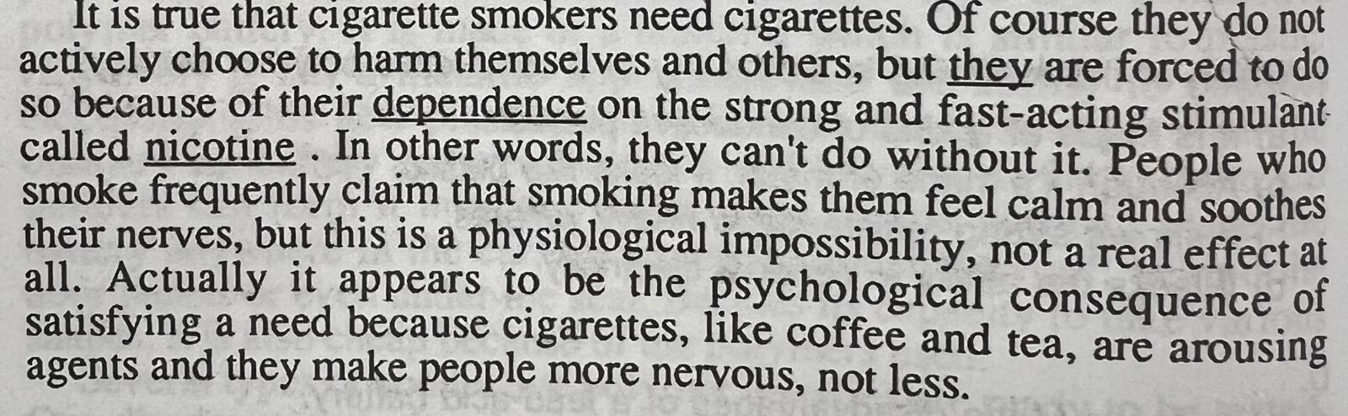

Slide 5
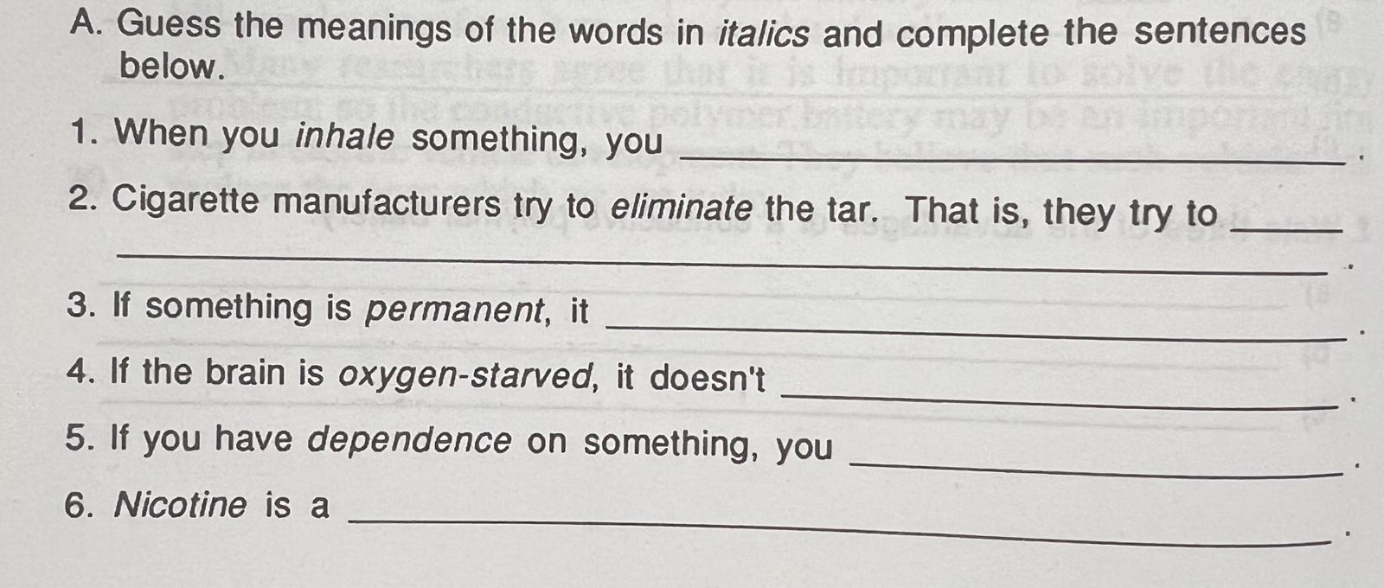

Slide 6
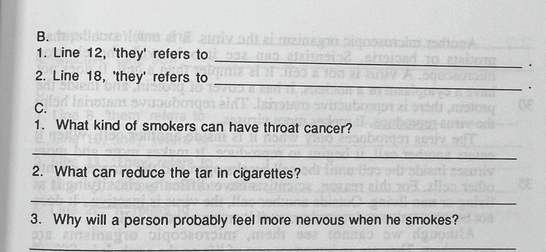

Slide 7
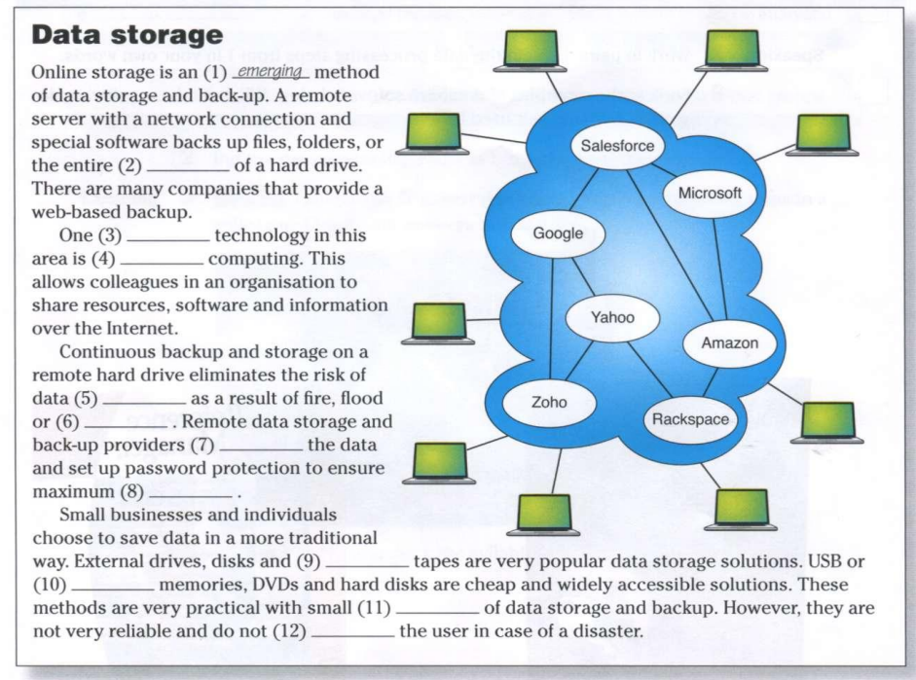
Cloud
Contents
Encrypt
Flash
Loss
Magnetic
Offsite
Protect
Security
Theft
Volumes

Slide 8
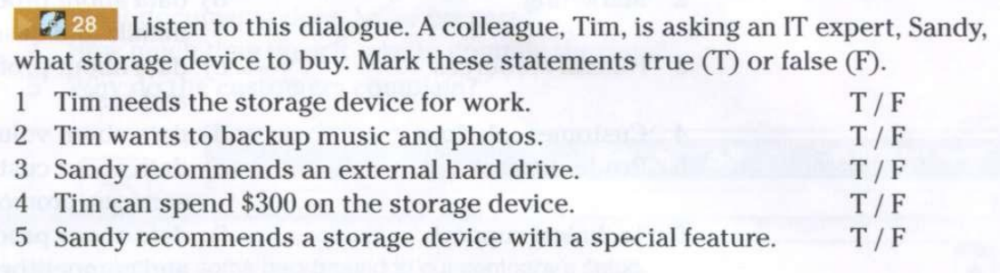

Slide 9
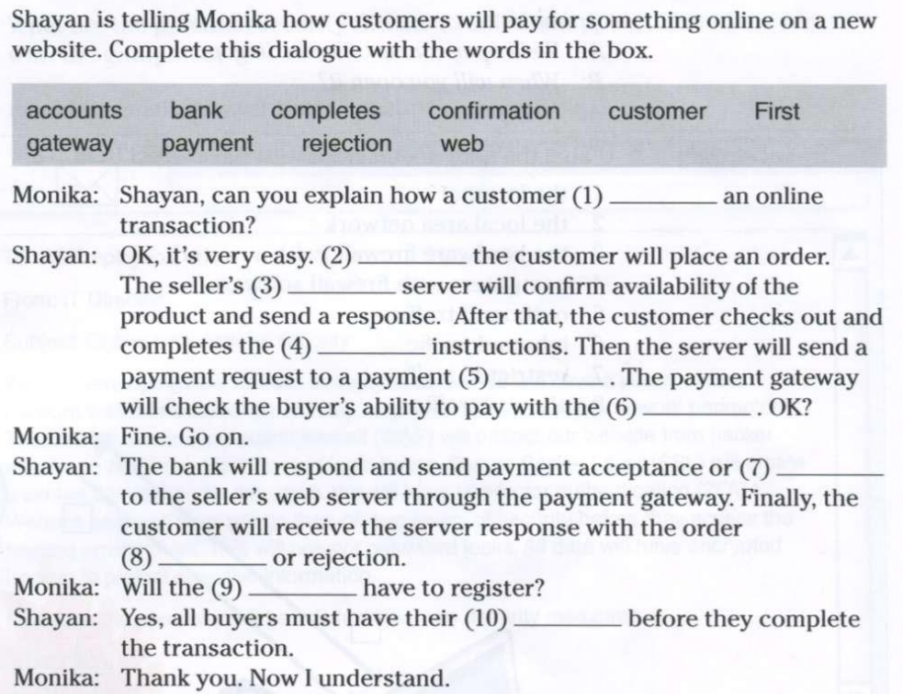

Slide 10
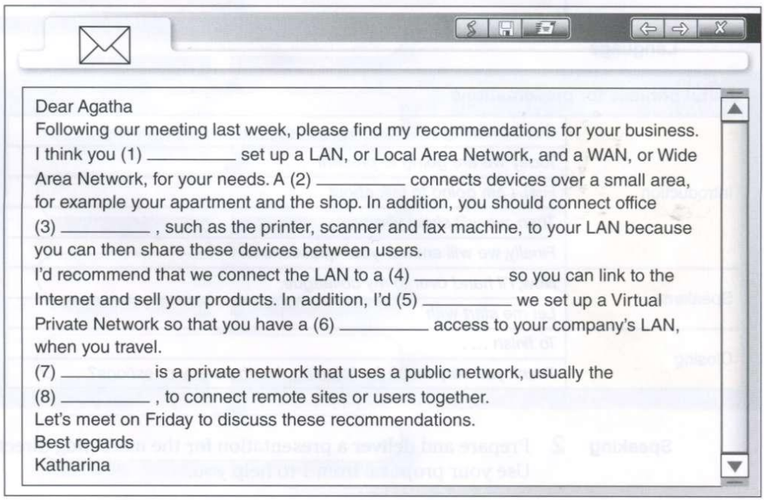
Equipment
İnternet
LAN
VPN
WAN
Recommend
Remote
Should

Slide 11
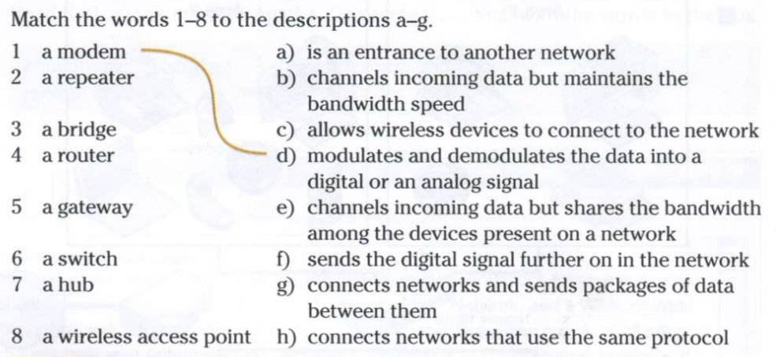

Slide 12
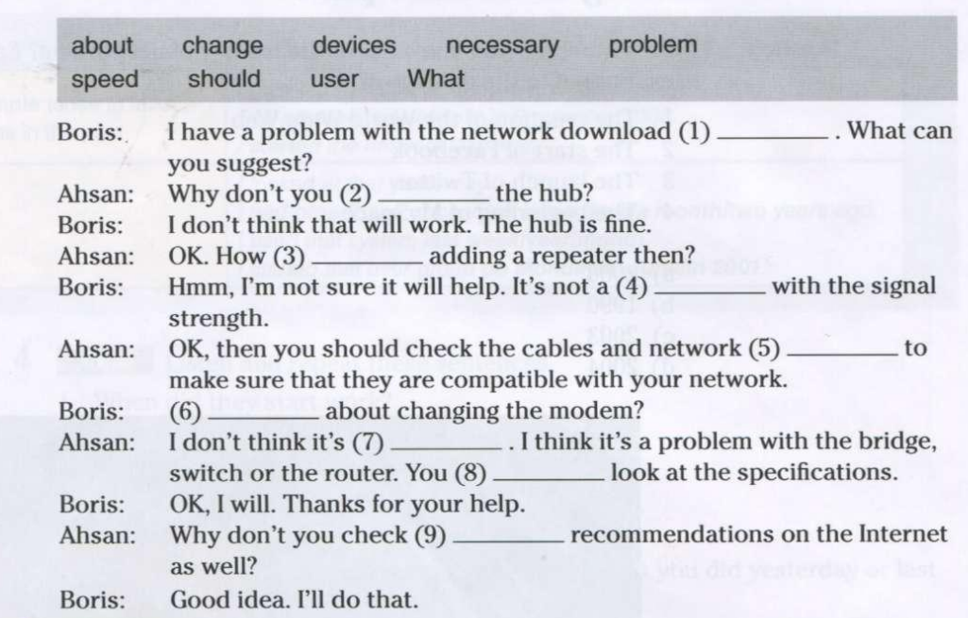

Slide 13
Listening
https://www.youtube.com/watch?v=AVpsLauNkBs
https://www.youtube.com/watch?v=U6ZBa5b5pqA

Slide 14
Writing
Write two paragraphs, one listing the benefits the other listing the negative aspects of replacing people with computers.

